Slide 1

GIVE ME SOME CREDITS

Slide 2
Problem Statement
Improve on the state of the art in credit scoring by predicting the probability that somebody will experience financial distress in the next two years.
Banks play a crucial role in market economies. They decide who can get finance and on what terms and can make or break investment decisions.
For markets and society to function, individuals and companies need access to credit.
Credit scoring algorithms, which make a guess at the probability of default, are the method banks use to determine whether or not a loan should be granted.
This competition requires participants to improve on the state of the art in credit scoring, by predicting the probability that somebody will experience financial distress in the next two years.

Slide 3
Objective:
The goal of this competition is to build a model that borrowers can use to help make the best financial decisions.

Slide 4
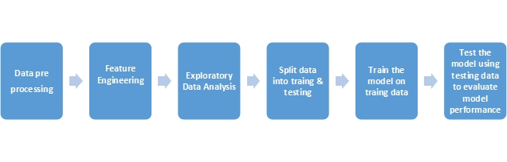
Work FLOW

Slide 5
Features
Variable Name | Description | Type
SeriousDlqin2yrs | Person experienced 90 days past due delinquency or worse | Y/N
RevolvingUtilizationOfUnsecuredLines | Total balance on credit cards and personal lines of credit except real estate and no installment debt like car loans divided by the sum of credit limits | percentage
age | Age of borrower in years | integer
NumberOfTime30-59DaysPastDueNotWorse | Number of times borrower has been 30-59 days past due but no worse in the last 2 years. | integer
DebtRatio | Monthly debt payments, alimony,living costs divided by monthy gross income | percentage
MonthlyIncome | Monthly income | real
NumberOfOpenCreditLinesAndLoans | Number of Open loans (installment like car loan or mortgage) and Lines of credit (e.g. credit cards) | integer
NumberOfTimes90DaysLate | Number of times borrower has been 90 days or more past due. | integer
NumberRealEstateLoansOrLines | Number of mortgage and real estate loans including home equity lines of credit | integer
NumberOfTime60-89DaysPastDueNotWorse | Number of times borrower has been 60-89 days past due but no worse in the last 2 years. | integer
NumberOfDependents | Number of dependents in family excluding themselves (spouse, children etc.) | integer

Slide 6
Objective The goal of this project is to build a model that borrowers can use to help make the best financial decisions.
Dataset Size
Training Dataset =150,000 Observations
Training Dataset =101,530 Observations

Slide 7
Data Exploration

Slide 8
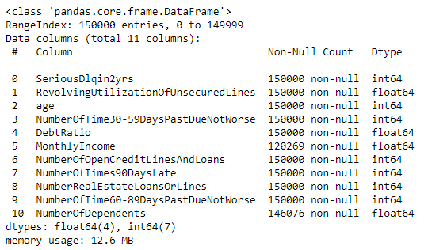
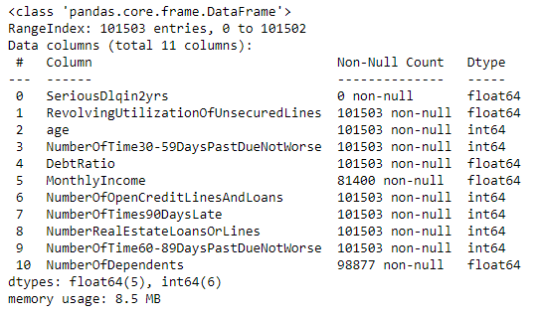
Info
Train
Test

Slide 9
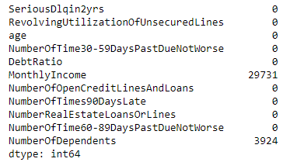
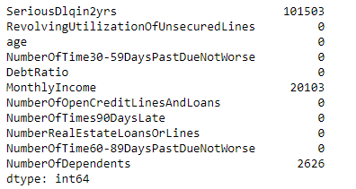
Null values
In Train data MonthlyIncome and NumberOfDependents have 29731 (19.82%) and 3924 (2.61%) null values respectively .
In Test data MonthlyIncome and NumberOfDependents have 20103(19.82%) and 2626(2.61%) null values respectively .

Slide 10
Handling Null Values
Imputaion Method are used for remove null Values :
Monthly Income imputed with normally distributed values with its mean
Number of Dependents imputed with its mode, which is zero.
Train :
Test:

Slide 11
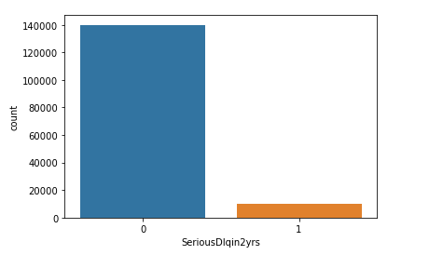
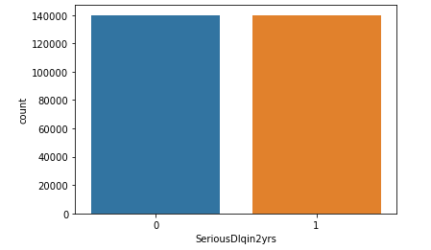
Treat Imbalace Data
The Target column ‘SeriousDlqin2yrs’ have imbalanced count .
Used SMOTE for treat imbalaced data .In fig (2) balace data is shown.

Slide 12
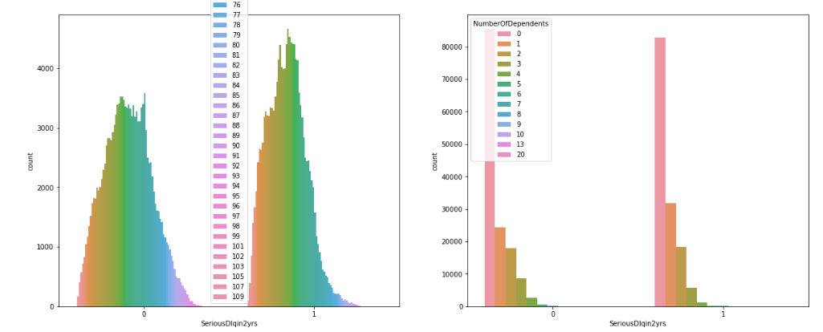
No. of dependents does not have any impact

Slide 13
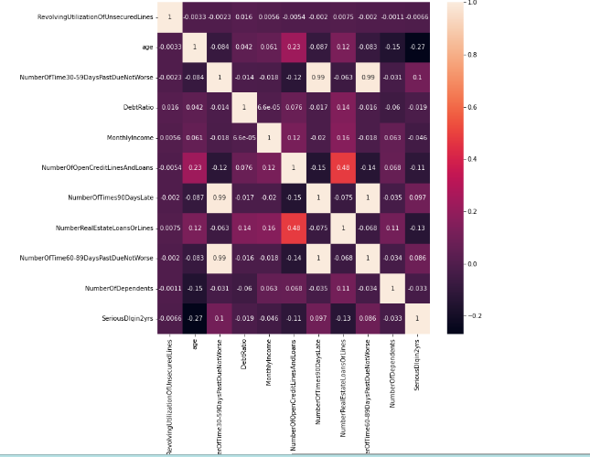
Check Correlation
age, NumberOfTime30-59DaysPastDueNotWorse, NumberRealEstateLoansOrLines are correlated with SeriousDlqin2yrs
Multicollinearity exists between:
NumberOfTime30-59DaysPastDueNotWorse and NumberOfTime60-59DaysPastDueNotWorse and NumberOfTimes90DaysLate\
NumberOfTime30-59DaysPastDueNotWorse is highly correlated with SeriousDlqin2yrs hence NumberOfTime60-59DaysPastDueNotWorse and NumberOfTimes90DaysLate could be dropped

Slide 14
Handling Outliers Detect outliers in following columns:
age
RevolvingUtilizationOfUnsecuredLines
NumberOfTime30-59DaysPastDueNotWorse
DebtRatio
These Outliers are treat with IQR method .

Slide 15
Standardization
Standardized the data in order to make the available data in a standard scale, so that it will be easy for machine to evaluate the data and get the more accurate predictions.

Slide 16

Split data into train, test

Slide 17
Model selection
Logistic Regression
Decision Tree
Random Forest
KNN

Slide 18

Accuracy score Highest accuracy score :Random forest (85.6475%)

Slide 19

ROC-AUC Scores Higest Score : Random forest(85.74055%)

Slide 20
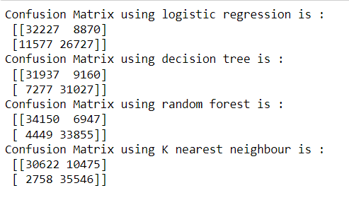
Confusion Matrix In this problem , Type I error is important .& We can see in this fig .type I error value is less of random forest

Slide 21
Conclusion
Random Forest is the one of best model for this problem,so borrowers can use to make the best financial decisions.

Slide 22
Future Scope
We can explore more machine learning algorithms in future
We can Use hyperparameter tuning & pruning methods for better accuracy

Slide 23
Thank You

